Slide 1
WICCI COUNCIL (Greece-India Business Council)
WOMEN´S INDIAN CHAMBER OF COMMERCE AND INDUSTRY
www.wicci.in
1

Slide 2
Council Vision &Mission
Type Text

Slide 3
Welcoming
Council Members to
WICCI
President, Vice President and 20+ Nominated
Council Members

Slide 4
CATHERINE SOFIANOU, Honorary President , Greece - India
Business Council, WICCI
President of SOFMEDICA Group, is a prominent figure in Europe's healthcare sector. Born in Cairo to a Greek family, she moved to Greece in 1963 and, alongside her husband, established a trading company. In 1994, recognizing opportunities in healthcare, she founded a company in Romania focused on high-end medical technologies, introducing innovations like the Artificial Heart and Robotically Assisted Minimal Invasive Surgery to the region.
Currently overseeing a family-owned group with over 160 healthcare professionals across Romania, Greece, Hungary, Bulgaria, and Cyprus, she actively contributes to various social not-for-profit organizations. Over the years, she has received numerous awards, including recognition for her contributions to fighting breast cancer, leadership in healthcare, and support for social projects.
Acknowledged internationally, Catherine Sofianou received honors from the Princess of Thailand, the Academy of Romanian Scientists, and the Pope and Patriarch of Alexandria and All Africa. Her philanthropic activities extend to cultural promotion, education, and Greek literature dissemination. Notably, she was named "Ambassador of Greek Diaspora" for her role in renovating the Greek Orthodox Church of Saints Constantine and Helen in Cairo.
Insert High Resolution Picture
4

Slide 5
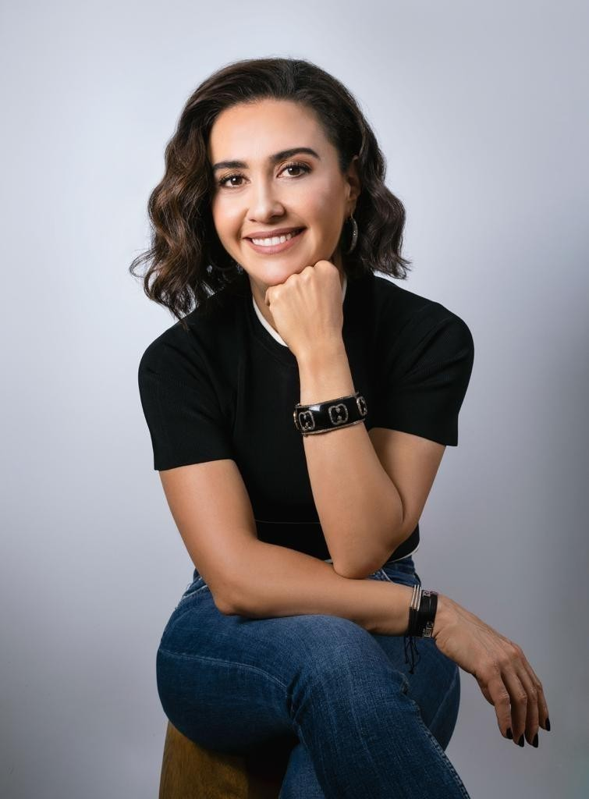
Foteini Dimopoulou, President , Greece - India
Business Council, WICCI
BIO :- Born in Athens in 1972. Graduated from
Pierce College in 1990 and later from Deree
College in 1994. Mother of two children, Panos aged 23 and Eirini aged 20. I started my professional career in 1990 at the family business "DIKINISI SA" in the logistics sector. Besides being a shareholder in the company, I also served as a packaging manager until 2007. With the sale of the company, I made a career shift and got involved in the jewelry industry, founding the company "ANAPNOE" where I currently work as the CEO. In 2017, I designed a collection that part
Insert High Resolution Picture
4

Slide 6
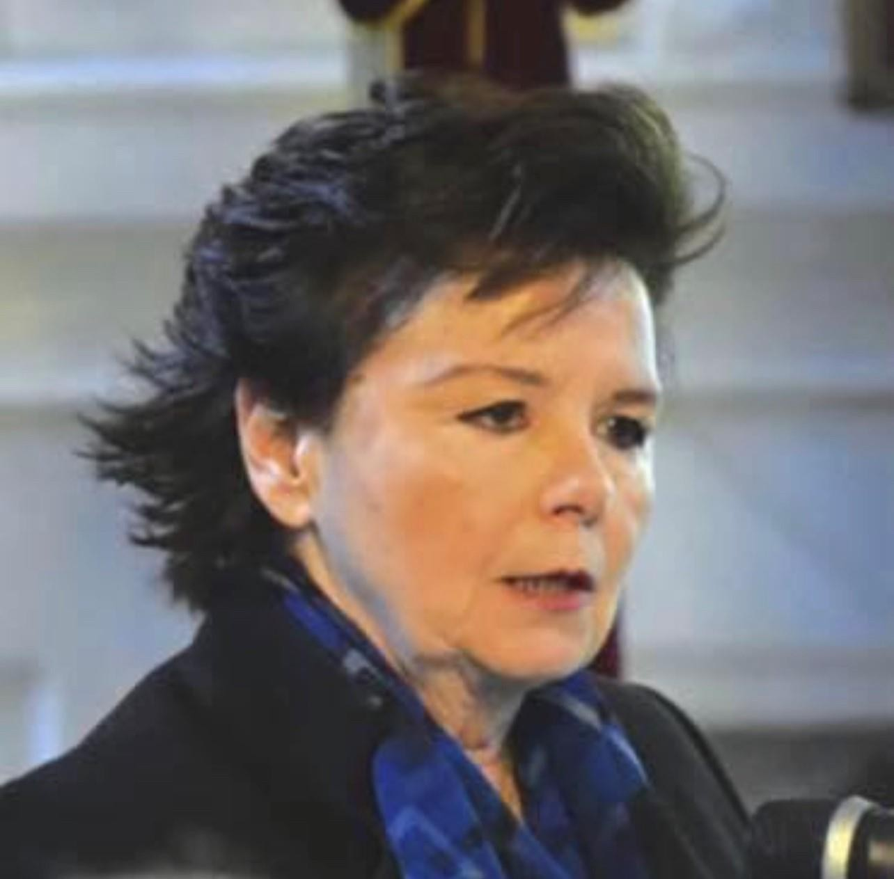
Tonia Moropoulou,Vice President, Greece - India
Business Council, WICCI
BIO :- Professor Emeritus At The National Technical University Of Athens
Chief Scientific Supervisor Of The Rehabilitation Of The Holy Aedicule
Of The Holy Sepulcher
Member Of The Executive Committee Of The Technical Chamber Of Greece
Member Of The Governing Council Of The University Of Ioannina
Insert High Resolution Picture
5

Slide 7
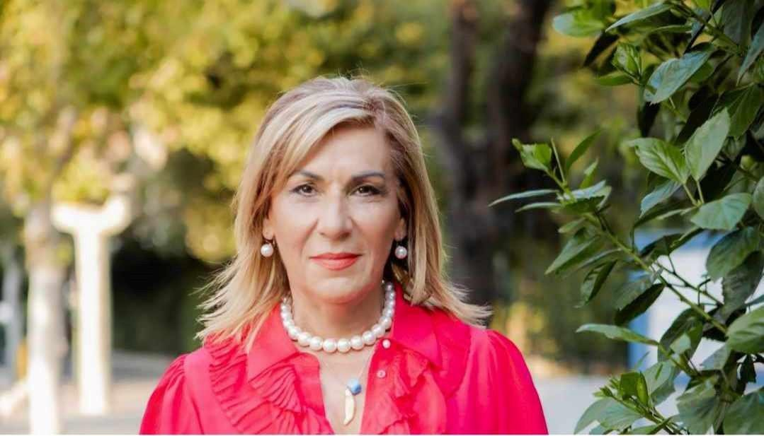
Chryssi Tseliou, Vice President, Greece - India
Business Council, WICCI
BIO :- I was born in Kos, the island of
Hippocrates, and graduated from the Hippocratic High School of Kos. I am the mother of two doctors and actively involved in tourism and hotel businesses, with a focus on issues related to accessible tourism.
Insert High Resolution Picture
My love for art and culture led me to create the "Chrysiis" gallery from 2010 to 2015, a multifunctional space showcasing young artists and hosting various cultural events.
6

Slide 8
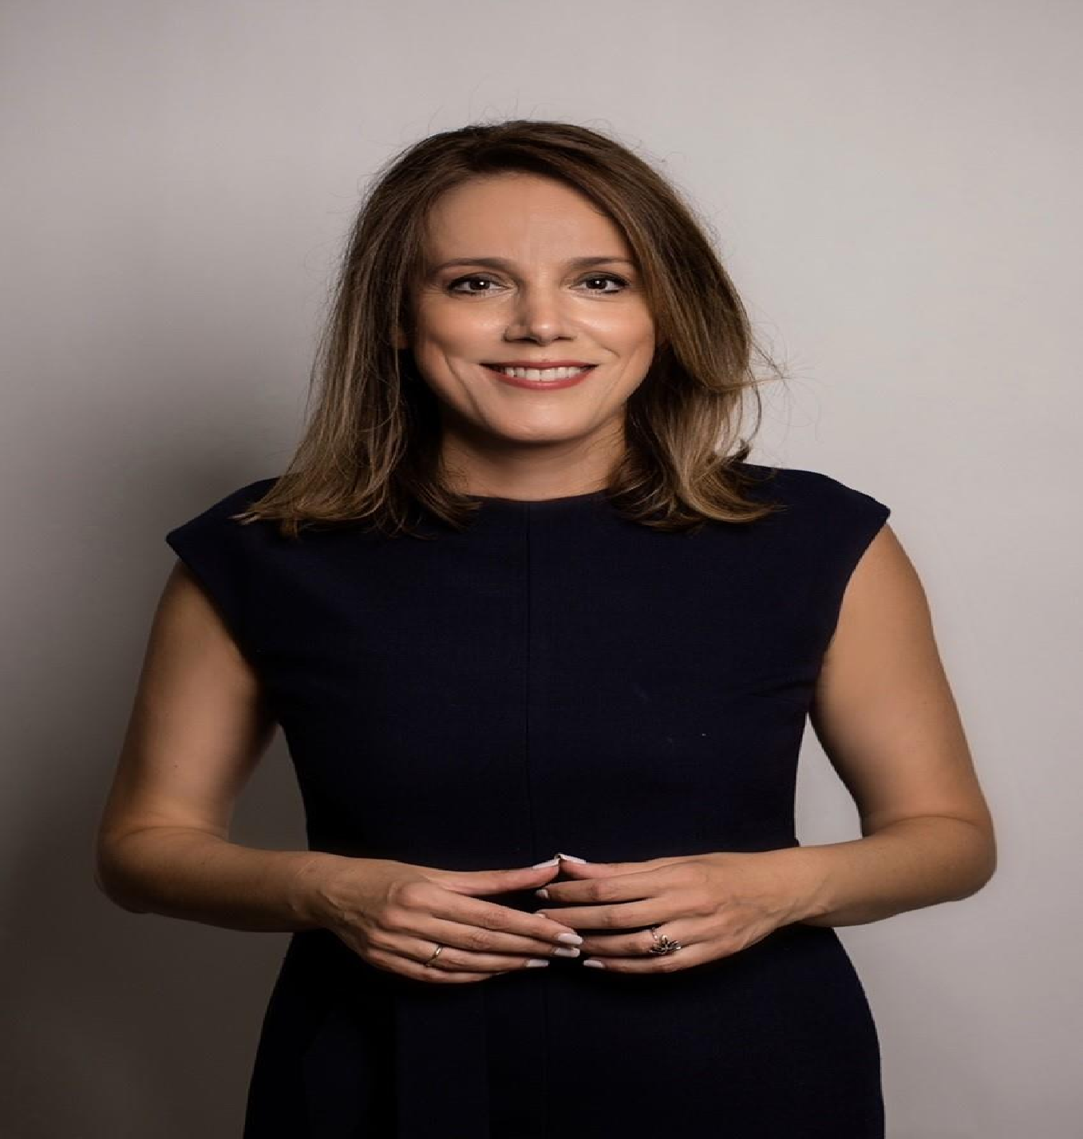
Evangelia Samoili, Council Member, Greece - India
Business Council, WICCI
BIO :- Evangelia Samoili, M.I.C.E Manager of
professional
Norstar SA, has an experience in the
extensive
tourism industry and
comprehensive skill set in Marketing, Sales, and
Quality Assurance. She considers herself a professional in the business of creating life lasting experiences, traveling being a vehicle rather than an end. She holds a Bachelor of Science Degree in Marketing Management from the American College of Greece A mother of two, Yiannis and Katherine Hantzandreou Andrews,
Insert High Resolution Picture
7

Slide 9
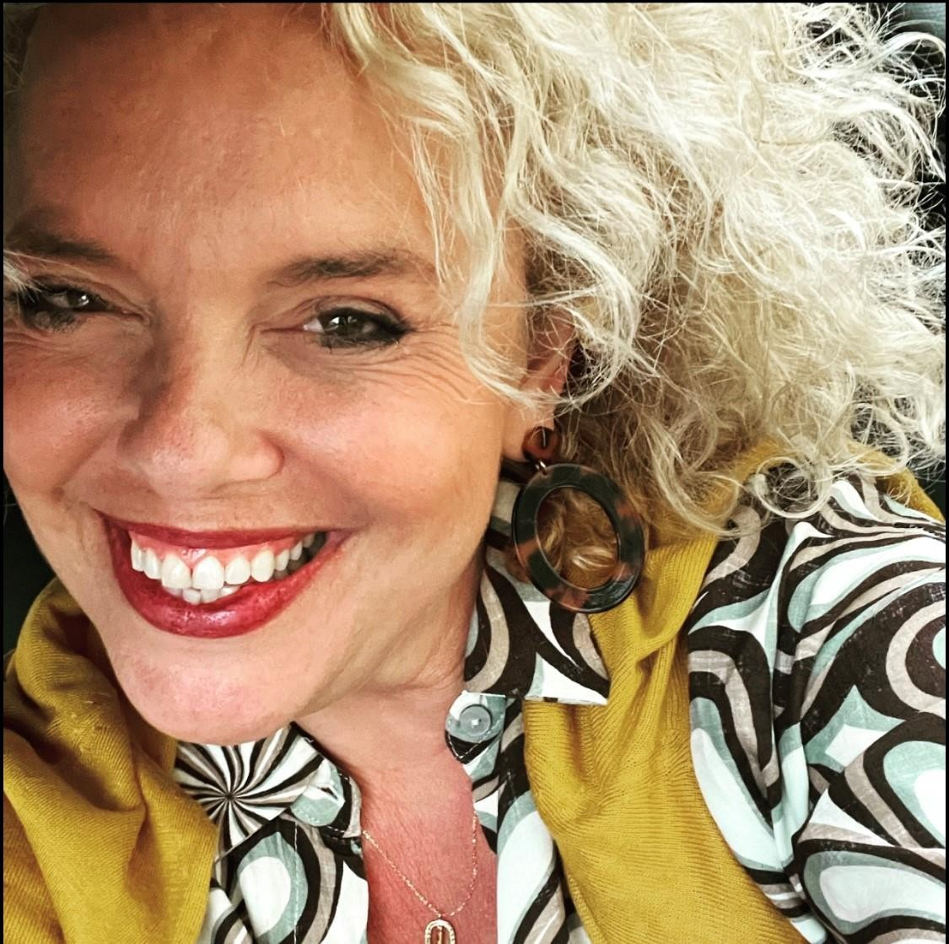
CV Jelina Tsagkanou Dimopoulou, Council
Member, Greece - India Business Council, WICCI
BIO :- My name is Jelina Tsagkanou Dimopoulou, and I was born in Athens in 1972. I went to
Moraitis School, and pursuing a degree
I graduated in Radiology
In 1989,
in the
Technological Educational Institute in Athens. I worked at Iatriko Hospital in the MRI department for 4 years and then I became a mother to Theano (22) and Spyros (18). In 2013, I became a volunteer for Make-A-Wish, and later became a full-time member of their team, for 5 years,
Insert High Resolution Picture

Slide 10
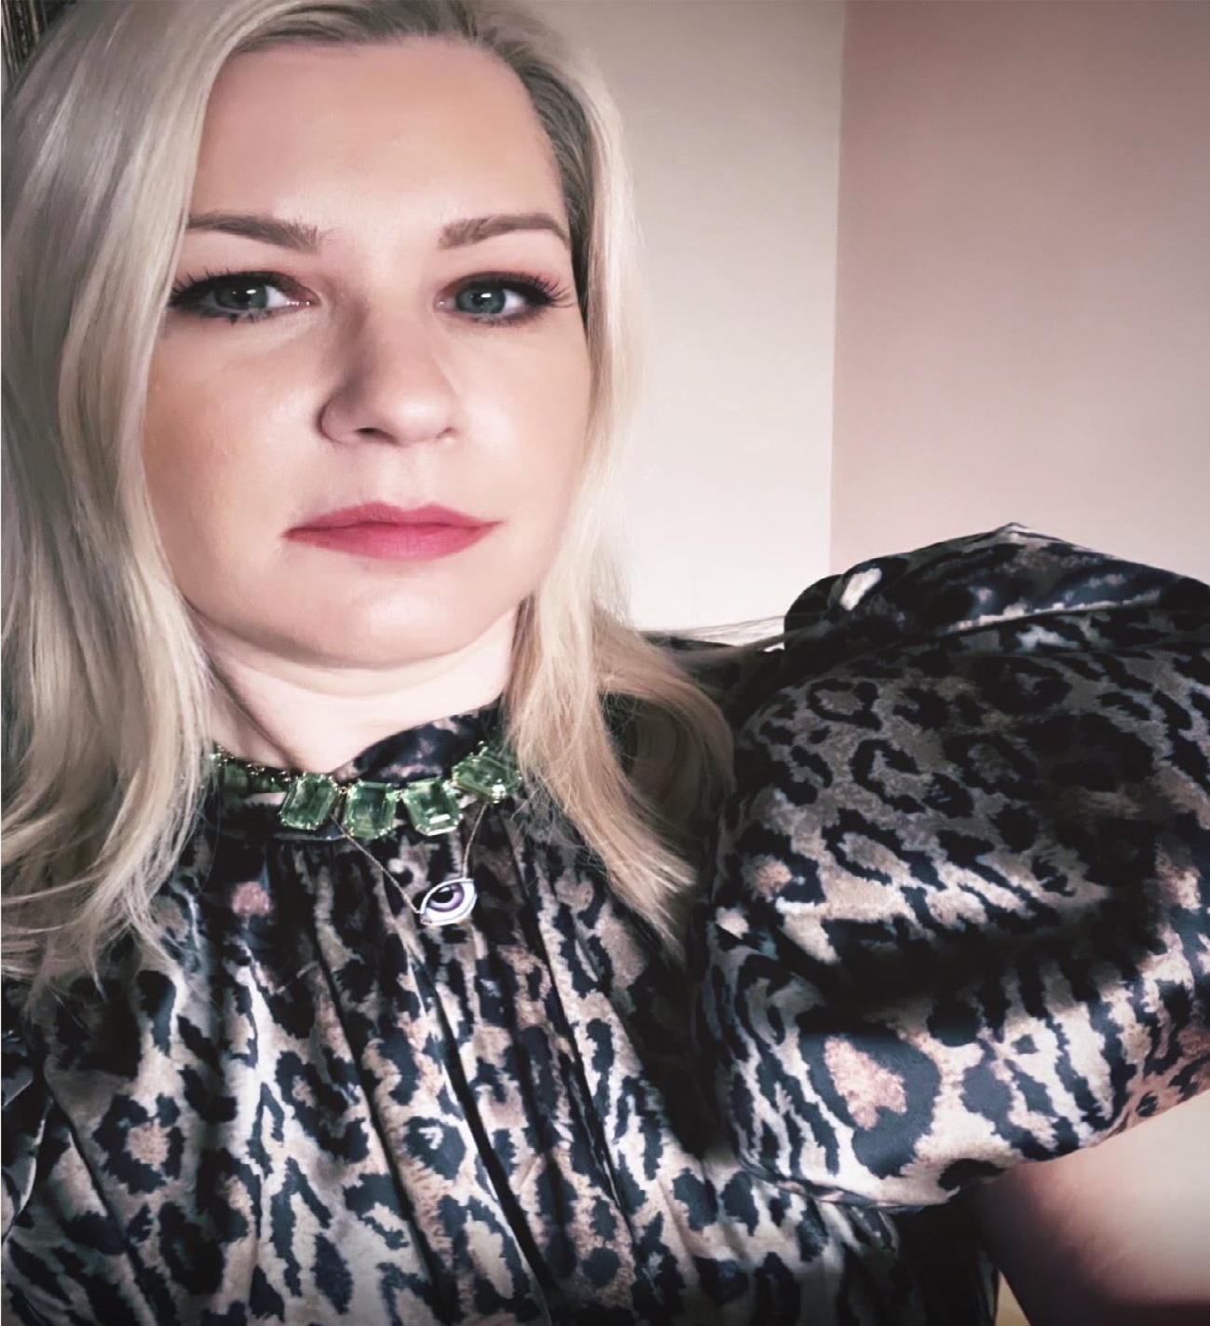
KATERINA KAPOGIANNOPOULOU-ARVANITI, Council
Member, Greece - India Business Council, WICCI
BIO :- In the past 25 years, I have gained valuable international experience in Business and Marketing. After completing my MSc in International Marketing in the UK, I started my career at INTRACOM, the leading Telecoms company in Greece during the 90s. In various
positions within the company, I had the opportunity to work in both R&D and Business Development. I actively participated in over 30 EU co-funded telecoms project
Insert High Resolution Picture
consortia, which involved frequent travel European Commission and collaborations
to the top
with
telecom players across Europe.

Slide 11
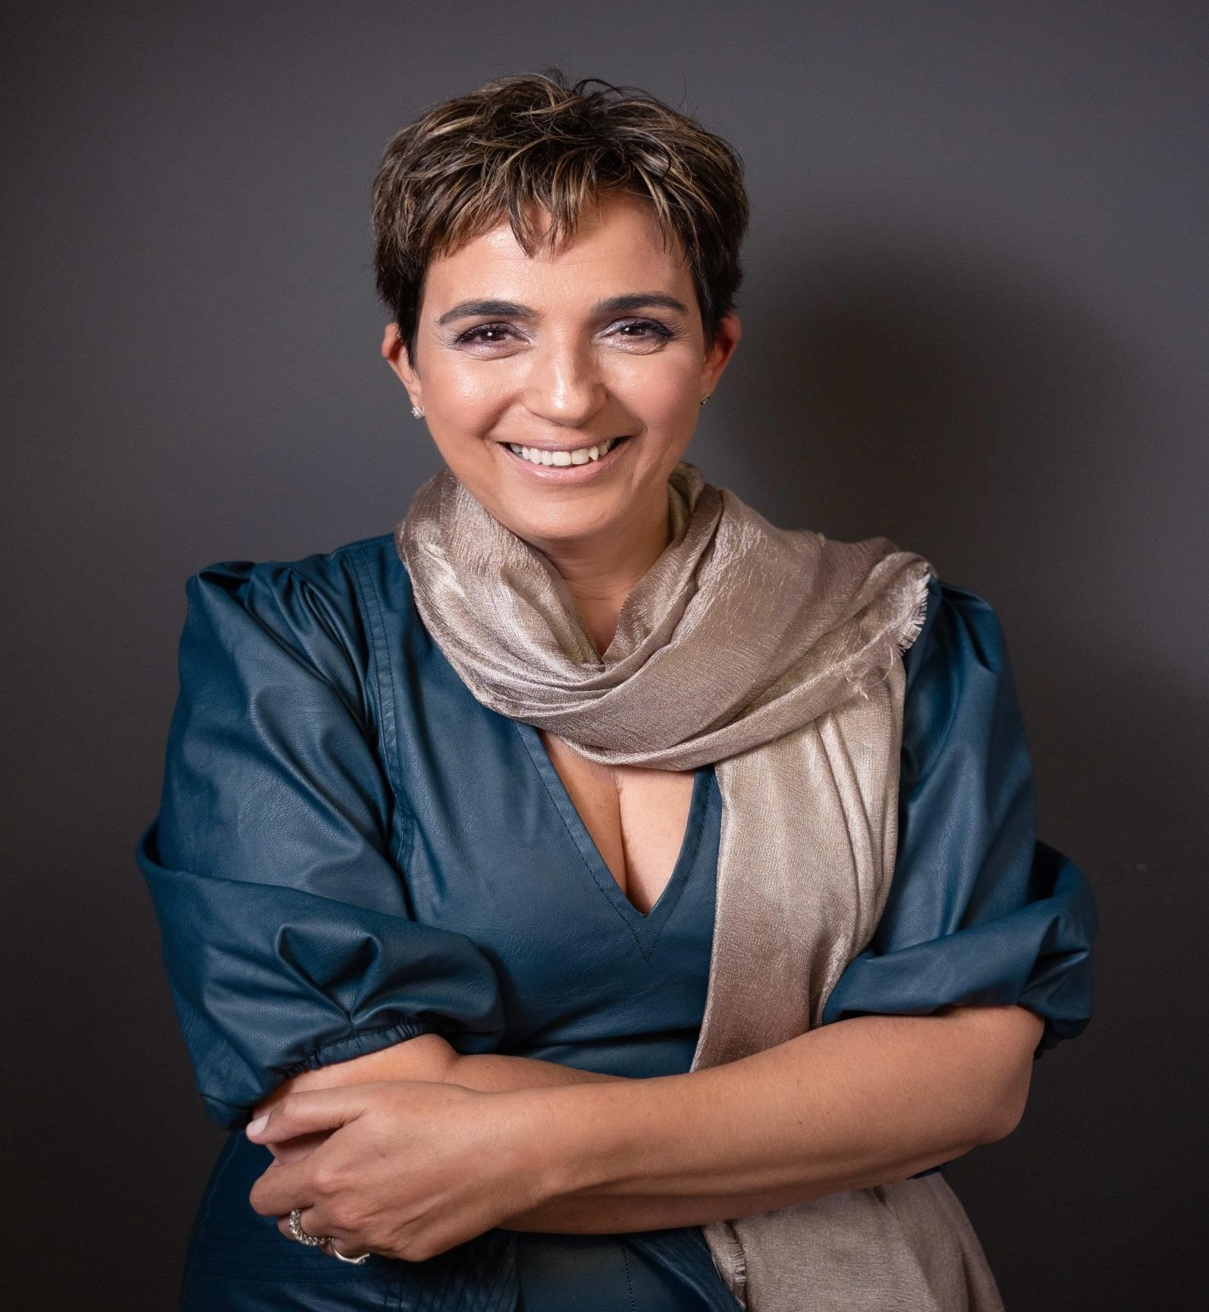
Machi Gavalas Council Member, Greece - India B WICCI
usiness Council,
With a rich background of knowledge and skills. My educational journey led me to attain a master’s degree in chemical engineering from the esteemed National Technical University of Athens, specializing in Plant Design. Additionally, having attained Business Excellence Model certification.
Proficient in Greek, Arabic, English, and French, my language skills emphasize my commitment to effective cross-cultural communication. I have been a proud member of the Technical Chamber of Greece since 1996 and the Egyptian Travel & Tourism Association since 2004, reflecting my dedication to continuous professional development and collaborative networking.
My professional footprint spans across Egypt, Greece, Europe, and North America, showcasing a broad understanding of diverse markets and cultures. My professional journey began working as a chemical engineer at Phillips in Eindhoven, Netherlands. My previous roles as a board member at NASCOTOURS SAE and managing partner at Bright Living SAE in Cairo demonstrate my commitment to excellence in contracting, operations, quality assurance, and logistics. Currently serving as the Vice President & CEO of NASCOTOURS SAE in Alexandria, Egypt, I steer the organization with a focus on developing, management, public relations, operations, and quality assurance.
In addition to my technical proficiency, I possess excellent IT skills, including MS Office, social media, and CRM applications. My leadership and communication skills have been pivotal in driving organizational success on a global scale.
Insert High Resolution Picture

Slide 12
, Council Member, Greece - India Business Council,
WICCI
Insert High Resolution Picture
BIO :-
Type Text

Slide 13
TYPE NAME & WICCI DESIGNATION
COUNCIL MEMBER, (…………. )COUNCIL WICCI
Insert High Resolution Picture
BIO :-
Type Text

Slide 14
TYPE NAME & WICCI DESIGNATION
COUNCIL MEMBER, (…………. )COUNCIL WICCI
Insert High Resolution Picture
BIO :-
Type Text

Slide 15
TYPE NAME & WICCI DESIGNATION
COUNCIL MEMBER, (…………. )COUNCIL WICCI
Insert High Resolution Picture
BIO :-
Type Text

Slide 16
TYPE NAME & WICCI DESIGNATION
COUNCIL MEMBER, (…………. )COUNCIL WICCI
Insert High Resolution Picture
BIO :-
Type Text

Slide 17
TYPE NAME & WICCI DESIGNATION
COUNCIL MEMBER, (…………. )COUNCIL WICCI
Insert High Resolution Picture
BIO :-
Type Text

Slide 18
TYPE NAME & WICCI DESIGNATION
COUNCIL MEMBER, (…………. )COUNCIL WICCI
Insert High Resolution Picture
BIO :-
Type Text

Slide 19
TYPE NAME & WICCI DESIGNATION
COUNCIL MEMBER, (…………. )COUNCIL WICCI
Insert High Resolution Picture
BIO :-
Type Text

Slide 20
TYPE NAME & WICCI DESIGNATION
COUNCIL MEMBER, (…………. )COUNCIL WICCI
Insert High Resolution Picture
BIO :-
Type Text

Slide 21
TYPE NAME & WICCI DESIGNATION
COUNCIL MEMBER, (…………. )COUNCIL WICCI
Insert High Resolution Picture
BIO :-
Type Text

Slide 22
TYPE NAME & WICCI DESIGNATION
COUNCIL MEMBER, (…………. )COUNCIL WICCI
Insert High Resolution Picture
BIO :-
Type Text

Slide 23
TYPE NAME & WICCI DESIGNATION
COUNCIL MEMBER, (…………. )COUNCIL WICCI
Insert High Resolution Picture
BIO :-
Type Text

Slide 24
TYPE NAME & WICCI DESIGN
COUNCIL MEMBER, (…………. )COUNCIL WICCI
ATION
Insert High Resolution Picture
BIO :-
Type Text

Slide 25
SUPPORTED BY
WICCI is supported by the massive global networks of ALL Ladies League (ALL), Women Economic Forum (WEF), and SHEconomy.
ALL is a movement of ‘Sisters Beyond Borders.’
WEF is a platform for ‘Business Beyond Borders.’ SHEconomy is e- commerce for women worldwide in Goods & Services for ‘Commerce Beyond Borders’

Slide 26
COUNTRIES
REPRESENTED
Albania, Angola, Armenia, Argentina, Australia, Azerbaijan, Bangladesh, Brazil, Burundi, Cameroon, Canada, Chad, China, Costa Rica, Croatia, Cyprus, Czech Republic, Colombia, Ecuador, Egypt, Ghana, Germany, Greece, Guatemala, Hong Kong, Hungary, India, Italy, Israel, Ireland, Japan, Kazakhstan, Kenya, Kyrgyzstan, Lesotho, Luxembourg, Malawi, Malaysia, Mexico, Moldova, Monaco, Montenegro, Morocco, Mozambique, Malta, Netherlands, Nigeria, Nepal, New Zealand, North Macedonia, Norway, Paraguay, Portugal, Peru, Puerto Rico, Philippines, Qatar, Romania, Russia, Rwanda, Serbia, Singapore, Slovenia, Spain, South Africa, South Korea, Suriname, Sweden, Switzerland, Syria, Tunisia, Turkey, Uganda, Ukraine, UK, Uruguay, Venezuela, Vietnam, Virgin Islands (US), UAE, USA, Uzbekistan, Zimbabwe2.5

Slide 27
WOMEN'S INDIAN CHAMBER OF COMMERCE ANDINDUSTRY
26

